Slide 1
BCSE307P — COMPILER DESIGN LAB
SheetGuard
A Compiler-Based Verification Engine for Spreadsheet Formulas,
Delivered as a Live Google Sheets Add-on
Submitted by
Harsh Vardhan Golhani – 24BAI0242
Utkarsh Raj– 24BCE2868
Shrijay Sinha– 24BCE2998
Under the guidance of
Nithya K, Assistant Professor Senior Grade II
VIT Vellore • School of Computer Science and Engineering • September 2026

Slide 2

THE MOTIVATION
Spreadsheets Run the World's Finances — Unverified
Spreadsheet formulas are, in every functional sense, a programming language — arithmetic expressions, conditionals, cross-cell references, and aggregations that millions of businesses run their finances on.
$6B
Yet unlike every other language people program in, spreadsheets have no lexical specification, no grammar, no type system, no static analysis, and no compiler.
JPMorgan's 2012 “London Whale” loss — partially traced to a single uncaught spreadsheet formula error.
Errors are caught only when the numbers look wrong — often after real financial damage has already occurred.
SheetGuard — BCSE307P Compiler Design Lab
2

Slide 3




PROBLEM STATEMENT
What's Missing in Every Spreadsheet
No Static Type System
No Dependency Analysis
Text, numbers, dates and currency freely intermix — errors are silently coerced rather than flagged.
Circular references are caught only after the fact; no one can see which cells a change will affect.
No Smell / Dead-Code Detection
No Compiled Execution Path
Copy-paste formula errors — a single wrong cell in a uniform column — go unnoticed and unexplained.
Every formula is re-interpreted cell-by-cell on every recalculation, with no optimization.
Every one of these gaps corresponds directly to a solved problem in classical compiler theory.
SheetGuard — BCSE307P Compiler Design Lab
3

Slide 4
THE SOLUTION
Treat the Spreadsheet as Source Code
SheetGuard builds a genuine compiler front-to-back over spreadsheet formulas — and exposes the results live, inside Google Sheets.
Lexer
Parser
AST
Semantic
Analysis
Optimization
Code
Generation
Not a pattern-matching linter. Not an LLM wrapper. A working compiler pipeline — every phase taught in BCSE307L has a real counterpart here.
The compiler doesn't just show an error — it explains, in a dependency graph and in plain English, exactly what is wrong, why, and how to fix it, then offers an auto-corrected copy of the sheet.
SheetGuard — BCSE307P Compiler Design Lab
4

Slide 5
SYLLABUS MAPPING
A Genuine Compiler Design Project
Every module of the BCSE307L syllabus is directly exercised by SheetGuard:
Syllabus Module | SheetGuard Component
Lexical Analysis | Formula lexer — tokenizes cell references, operators, literals, function names
Syntax Analysis / Parsing | Recursive-descent parser producing a full AST per formula
Intermediate Representation | AST plus whole-sheet Dependency DAG
Semantic Analysis | Type & dimension checker; bug/smell detector
Code Optimization | Constant folding and dead-cell elimination over the DAG
Code Generation / Execution | Compiled Python/NumPy engine, benchmarked vs. naive recalculation
Symbol Tables | Named-range / cross-sheet symbol table — like linking across object files
SheetGuard — BCSE307P Compiler Design Lab
5

Slide 6
HOW IT WORKS
System Architecture
Google
Sheet
Sidebar
(Apps Script)
SheetGuard
Backend
(Compiler Pipeline)
Live Result
in Sheet
1
User opens the SheetGuard sidebar inside their own Google Sheet.
2
The Add-on (Google Apps Script) reads every formula & value, sends structured JSON to the backend.
3
The backend runs the full compiler pipeline: parse → analyze → optimize → compile.
4
The sidebar renders results live — problem cells highlighted directly in the sheet.
SheetGuard — BCSE307P Compiler Design Lab
6

Slide 7
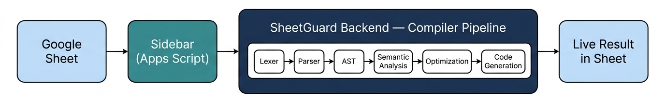
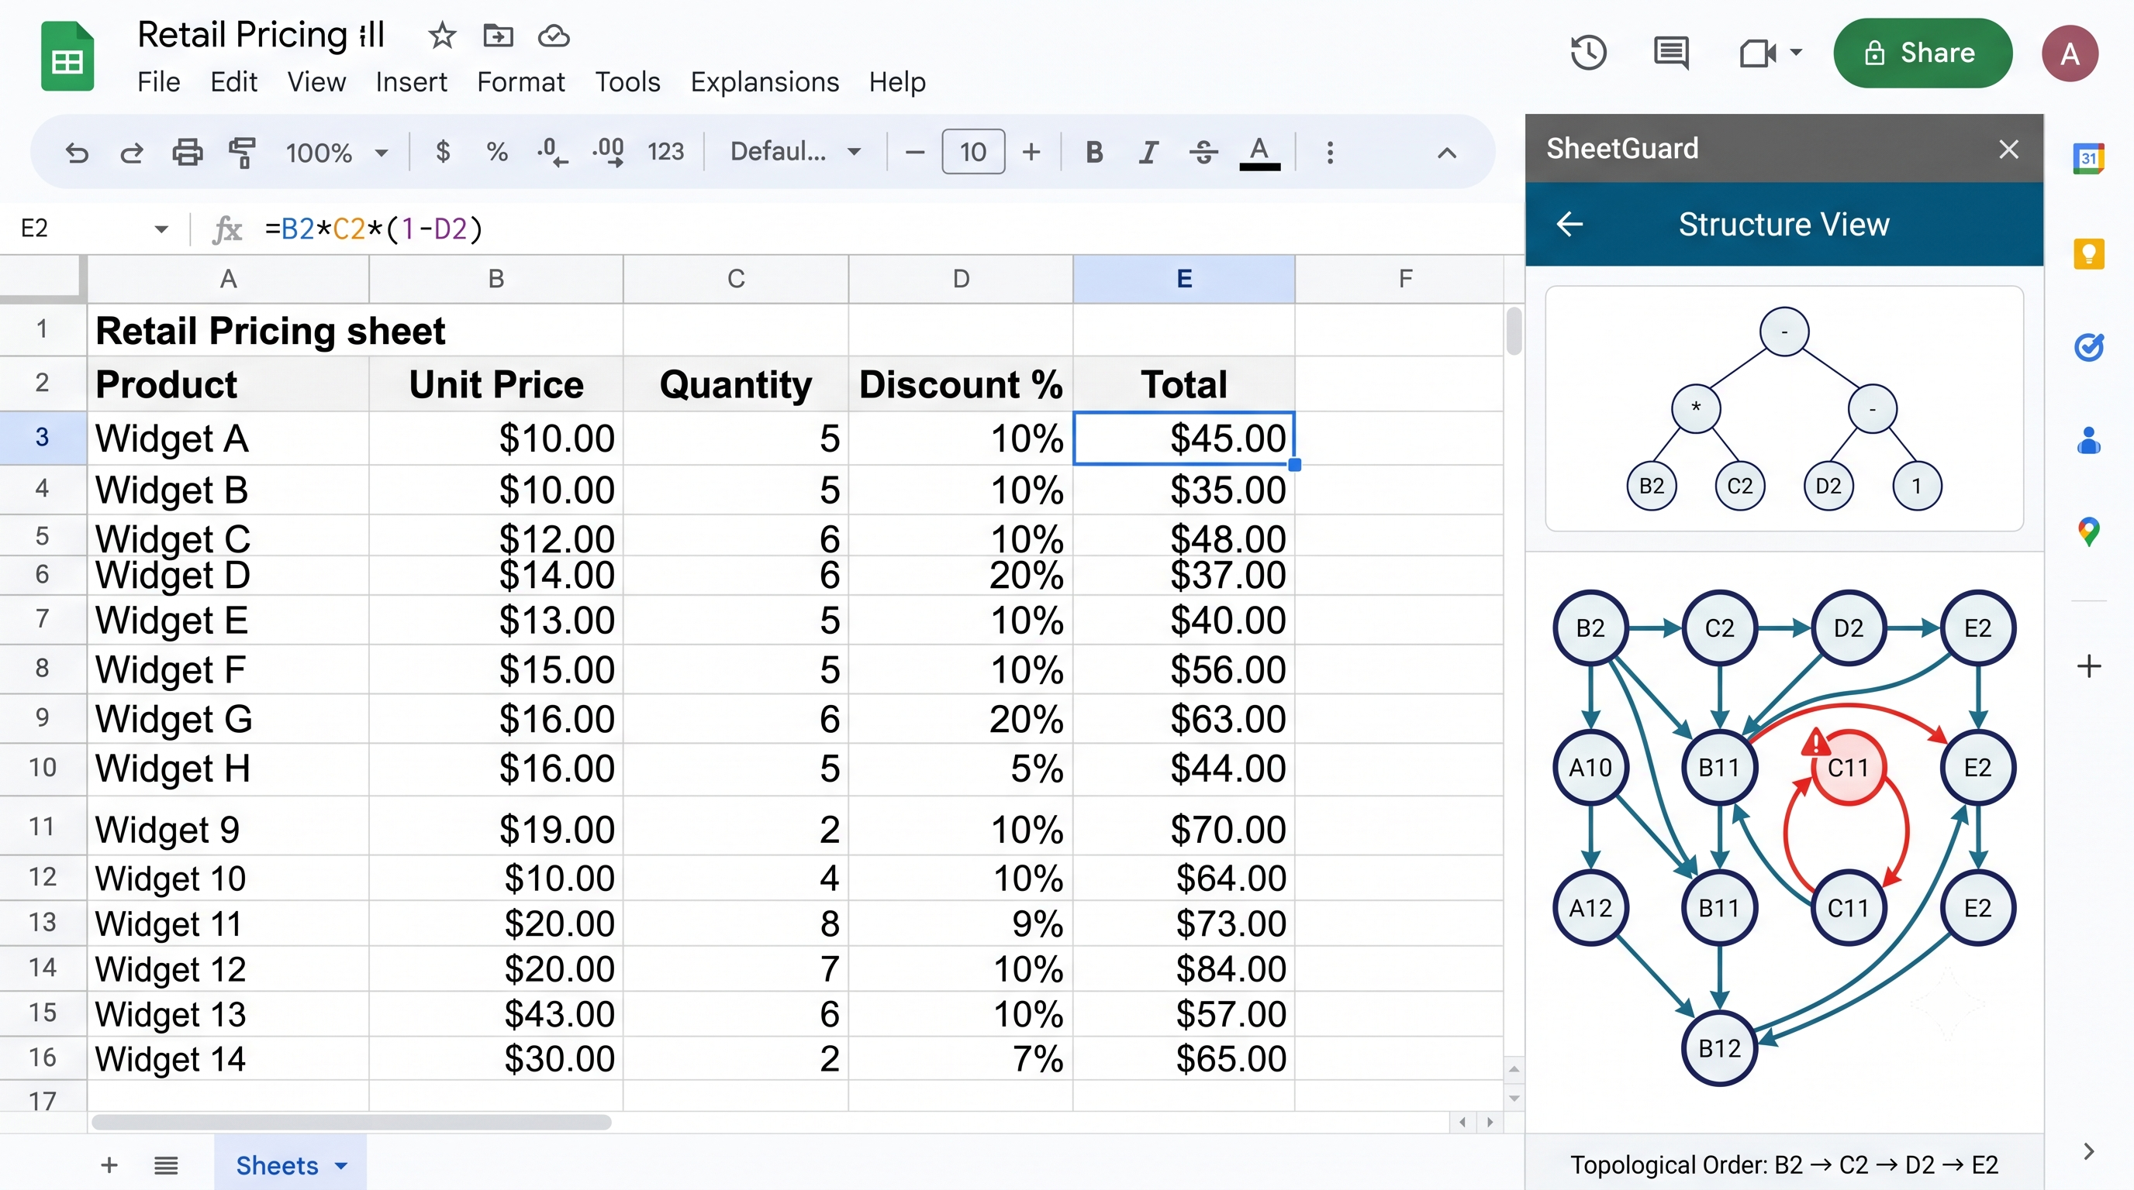
HOW IT WORKS
Backend Pipeline in Detail
SheetGuard — BCSE307P Compiler Design Lab
7

Slide 8



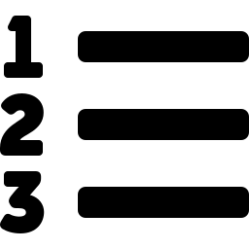

TIER 1 — MUST-HAVE
Core Pipeline Modules
Lexer
Recursive-Descent Parser
Dependency Graph Builder
Tokenizes formula strings into operators, literals, cell references, ranges, function names.
Produces a full AST for arithmetic, ranges, nested functions, and cross-sheet references.
Constructs the whole-sheet Dependency DAG — cells as nodes, references as edges.
Cycle Detector
Topological Sorter
Type & Dimension Checker
Runs graph cycle detection to identify and highlight circular references.
Computes the correct, minimal recalculation order across the sheet.
Inferred type system (Number, Text, Date, Currency...) flags unsafe coercions.
SheetGuard — BCSE307P Compiler Design Lab
8

Slide 9



TIER 2 — HIGH-IMPACT ADDITIONS
Analysis & Delivery Modules
Bug / Smell Detector
Optimizer
Inconsistent formula patterns across a row/column, off-by-one ranges, hardcoded values.
Constant folding and dead-cell elimination — classical passes applied to the DAG.
Summary Generator
Sidebar UI
Plain-English sheet summary from structural features; LLM phrases only the final sentence.
Renders all three output views and highlights flagged cells inside the live sheet.
SheetGuard — BCSE307P Compiler Design Lab
9

Slide 10
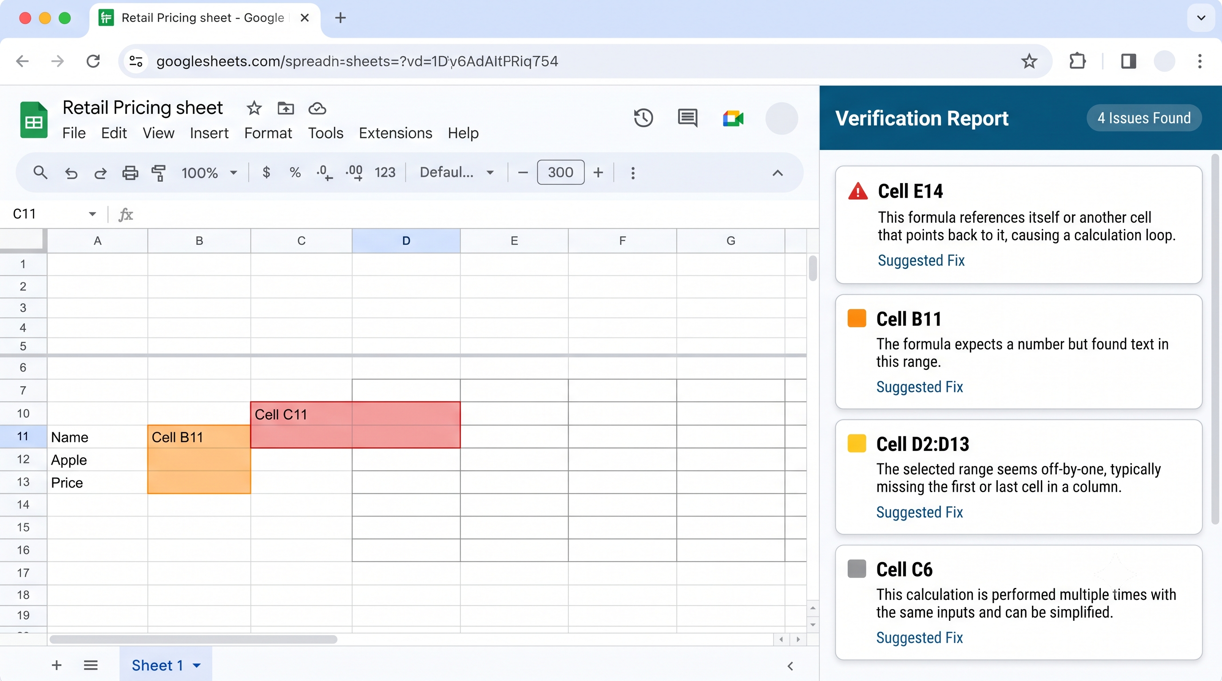

Slide 11



FROM COMPILER INTERNALS TO PLAIN ENGLISH
Sidebar Output — Three-Layered View
BUTTON 1
BUTTON 2
BUTTON 3
Structure View
Verification Report
Deliverables
AST & Dependency DAG
Bugs & Warnings
Summary & Corrected Sheet
The parsed AST for the selected cell, plus the whole-sheet DAG as an interactive graph. Cycles highlighted in red; topological order listed alongside.
Every detected issue — cell address, category, plain-English explanation, and a suggested fix. Click to jump to the cell.
A plain-English sheet summary, plus a downloadable annotated copy with every flagged cell commented and corrected.
SheetGuard — BCSE307P Compiler Design Lab
10

Slide 12
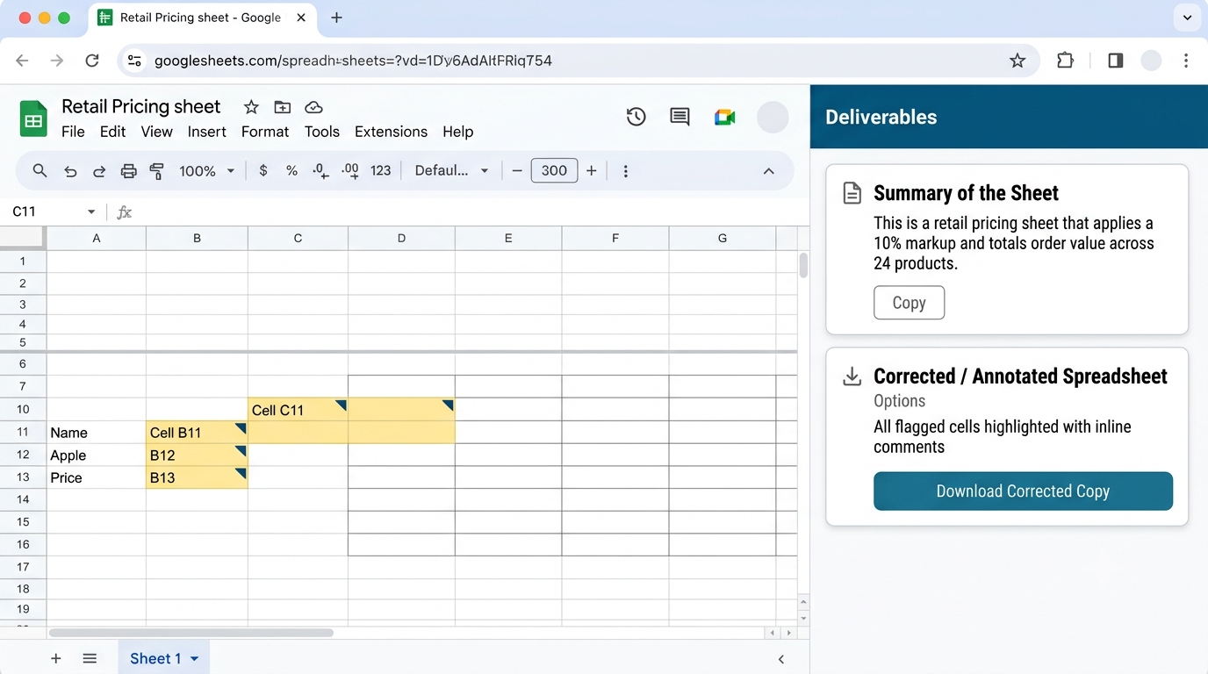

Slide 13
FROM COMPILER INTERNALS TO PLAIN ENGLISH
Sidebar Output in Action
Structure View
AST & Dependency DAG
Verification Report
Bugs & Warnings
Deliverables
Summary & Corrected Sheet
SheetGuard — BCSE307P Compiler Design Lab
11

Slide 14
ROADMAP
Feature Build Priority
TIER 1
TIER 2
FUTURE
Must-Have
High-Impact Additions
Proposed, Not Built This Semester
Formula lexer & recursive-descent parser → full AST
Whole-sheet Dependency DAG construction
Circular-reference detection
Topological sort for recalculation order
Type & dimension checker
Bug/smell detector
Constant folding & dead-cell elimination
Sheet summary generation
Compiled Python/NumPy execution engine
Symbol table for named ranges & cross-sheet refs
Multi-target codegen (SQL / JavaScript)
Semantic diffing between workbook versions
Formula fuzz-testing from inferred types
SheetGuard — BCSE307P Compiler Design Lab
12

Slide 15





WHAT IT'S BUILT ON
Technology Stack
Front-end / Sidebar
Google Apps Script, HTML Service — container-bound script
Compiler Backend
Python — lexer, parser, AST, semantic analysis, optimization passes
Execution Engine
Python / NumPy — compiled evaluation engine for benchmarking
Hosting
Free-tier cloud host (Render / Railway / Fly.io) — private, unguessable URL
Summary Generation
LLM used only for final-sentence phrasing — never for structural analysis
SheetGuard — BCSE307P Compiler Design Lab
13

Slide 16

NO MARKETPLACE PUBLISHING
Deployment Strategy — Private by Design
1
Container-bound Apps Script
Code attached directly to one specific Google Sheet — not a published, stand-alone Add-on. Only the owner's account needs to grant permission.
2
No submission, no review
100% Private,
Personal-Use Tool
No other user can see or install it unless that exact sheet is explicitly shared with them.
Never submitted to, listed on, or reviewed by the Google Workspace Marketplace.
3
Free-tier backend, unguessable URL
The compiler backend runs on a free-tier host (Render / Railway / Fly.io) with a private URL known only to the script that calls it.
SheetGuard — BCSE307P Compiler Design Lab
14

Slide 17

PUTTING IT ALL TOGETHER
Expected Outcome — The Final Demo
A real spreadsheet with realistic, relatable bugs — walked through all three sidebar views, entirely from inside the sheet:
STEP 1
STEP 2
STEP 3
STEP 4
Inject realistic bugs
Show compiler internals
List detected issues
Generate summary + fix
A copy-paste formula error, an off-by-one SUM range, a currency/percentage mismatch.
The AST for a selected cell and the whole-sheet dependency DAG, rendered live.
Every bug flagged with cell address, category, plain-English cause, and fix.
A one-paragraph sheet summary, plus a corrected, annotated copy of the workbook.
SheetGuard — BCSE307P Compiler Design Lab
15

Slide 18
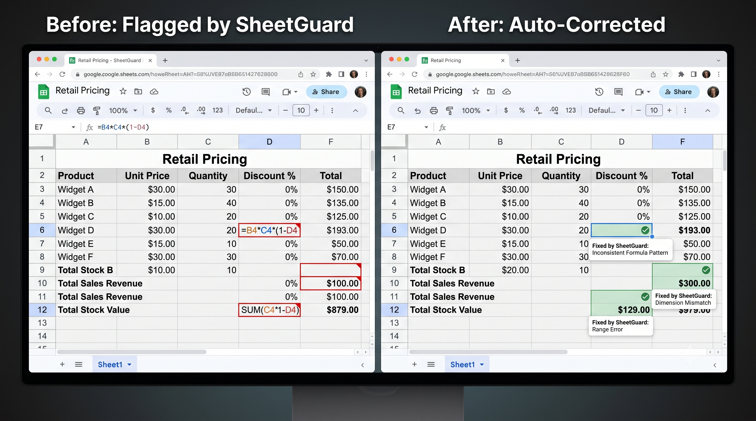
PUTTING IT ALL TOGETHER
Live Preview — Before & After
SheetGuard — BCSE307P Compiler Design Lab
16

Slide 19
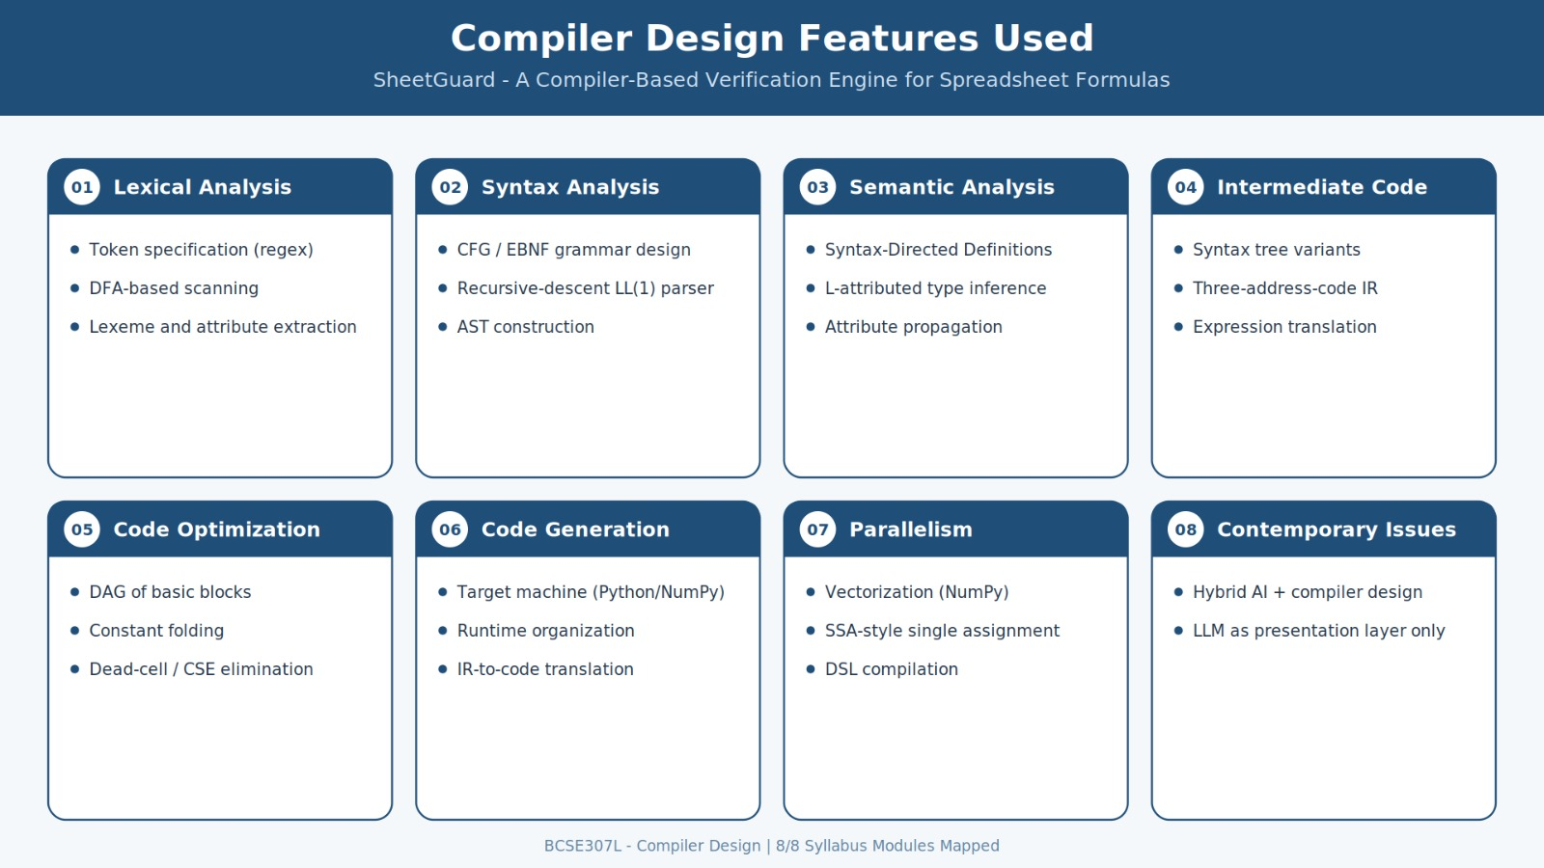

Slide 20
Conclusion & Future Work
SheetGuard shows that a classical compiler pipeline — lexer through code generation — can be meaningfully applied to spreadsheet formulas, a language that has never had this level of tooling despite being one of the most widely used programming environments in the world.
WHERE IT GOES NEXT
Multi-target codegen
Emit equivalent SQL or JavaScript from the same dependency DAG.
Semantic diffing
AST-level diff between two workbook versions, not a plain text diff.
Formula fuzz-testing
Auto-generate boundary test values from inferred types.
SheetGuard — BCSE307P Compiler Design Lab
17

Slide 21
Thank You
SheetGuard — BCSE307P Compiler Design Lab | [Team Names] | Guide: Nithya K

